Slide 1
Using the DBGI Project Registration Portal
One deal, from registration to approved price, with real screens
Walkthrough for company users and DBGI administrators | 2026-10-26

Slide 2
Two kinds of users
Everyone signs in at the same portal, but sees different screens
Company user
DBGI administrator
Works for a partner dealer.
Registers deals, answers DBGI's questions, and checks decisions and approved prices.
Works for DBGI.
Reviews every registration, decides matches and prices, and keeps master data clean.
Uses: Registrations, Notifications, Rankings, Help
Uses: Registration pages and the Administration area
Every slide that follows shows a chip in the top-right corner saying who does that step.

Slide 3
The journey we will follow
A real registration, DBGI-000012, created in the portal's test environment
The example deal
1
Sign in
Both
Dealer: DEMO ONLY - Sample Partner (a demo company)
Buyer (End-user): Pasig City Schools Division Office
Needs: 20 laser printers, model M1820W
List price: PHP 10,000 each
Competitor: Canon at PHP 9,300
Dealer asks DBGI for: PHP 9,000
2
Create and submit the registration
Company user
3
Review it and ask for a correction
DBGI administrator
4
Correct it and resubmit
Company user
5
Confirm the registration
DBGI administrator
6
Approve the price
DBGI administrator
7
See the decision and approved price
Company user
8
Check the ranking
Company user
Steps 3 and 4 are optional in real life: they only happen when DBGI needs more information.

Slide 4
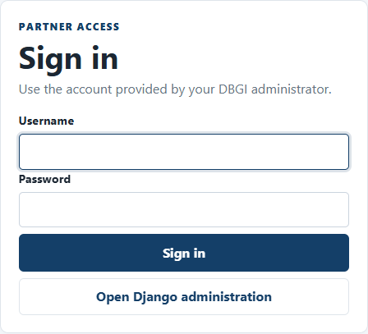
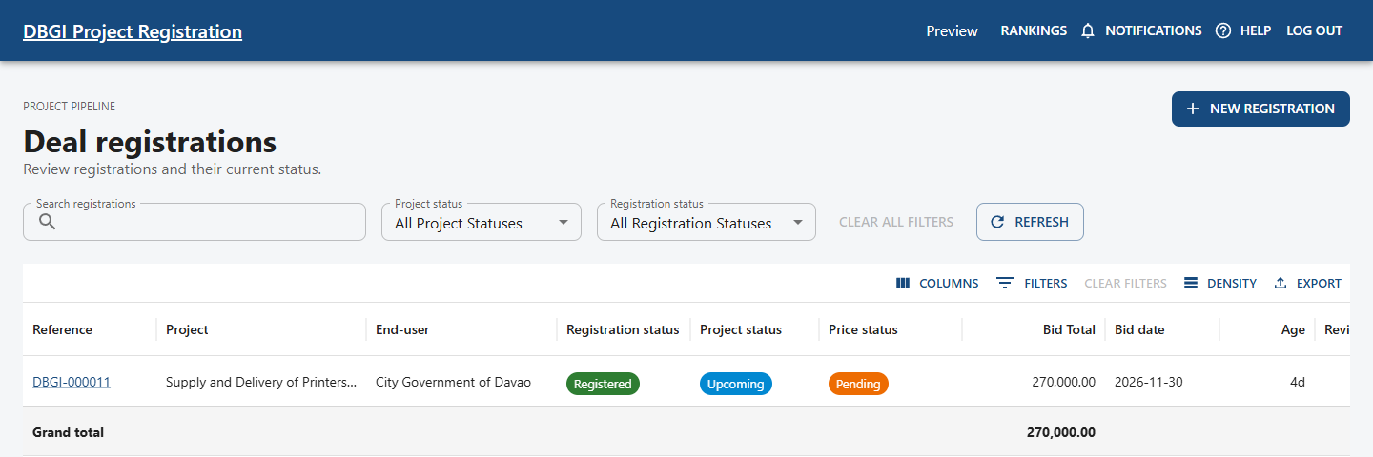
Sign in and find your way
Step 1 | Both
The registrations list is your home page
Sign in with the username and password DBGI gave you. Test environments also show one-click test accounts.
The top menu has Rankings, Notifications, Help, and Log out. DBGI administrators also see Administration.
Company users start a deal with NEW REGISTRATION. Each row in the table is one registration; click its reference to open it.

Slide 5
Read the three status badges separately
Every registration shows three badges. They answer different questions.
Registration status
Project status
Pricing status
Is the deal accepted by DBGI?
Is the procurement itself going ahead?
Has DBGI decided the price?
Submitted
Not linked
Pending
Under review
Upcoming
Changes requested
Changes requested
Active
Partially approved
Resubmitted
Won
Approved
Registered
Lost
Rejected
Review required after edit
Cancelled
Expired
Rejected
On hold
Example: a deal can be Registered with Pricing still Pending. Hover over any badge in the portal to see what it means.

Slide 6
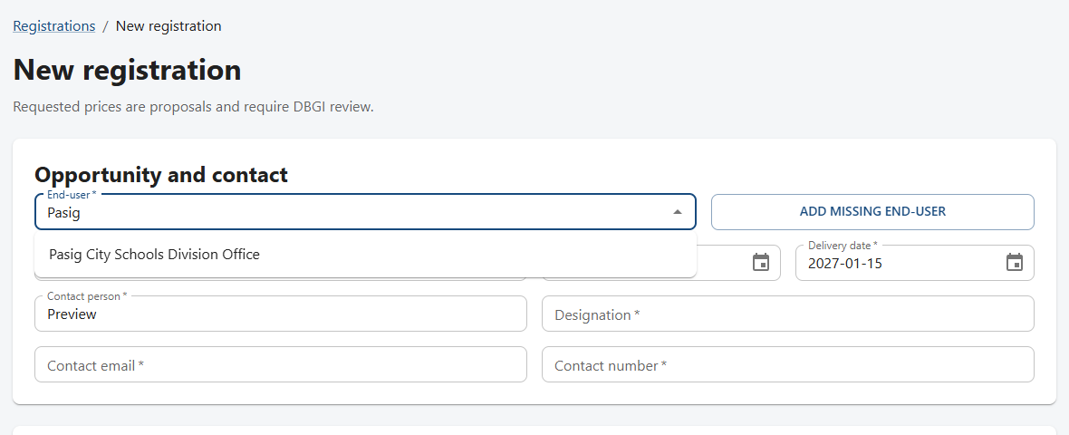
Create a registration: who and what
Step 2 | Company user
Start from Registrations, then NEW REGISTRATION
Type part of the buyer's name in End-user and pick the match. A green line confirms the address and that DBGI verified it.
Not in the list? Use ADD MISSING END-USER. DBGI verifies it later.
Enter the project title, bid date, and delivery date.
Check the contact details. They are filled from your profile.
Register each real opportunity once. To fix something later, edit the existing registration instead of creating a new one.

Slide 7
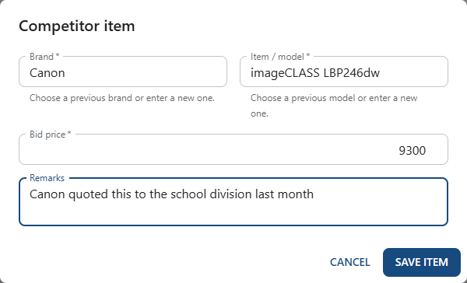
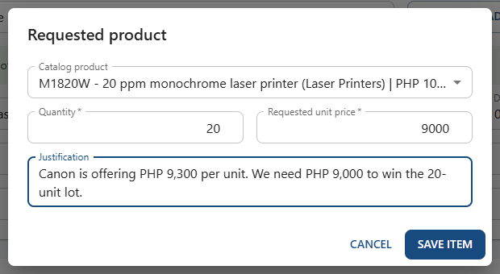
Add the competitor and the products you need
Step 2 | Company user
Both tables need at least one row
Select ADD COMPETITOR.
Pick or type the brand and model, their bid price, and a remark. Only you and DBGI see this.
Select ADD PRODUCT and choose the catalog product.
Enter quantity, the unit price you are requesting, and why you need it.

Slide 8
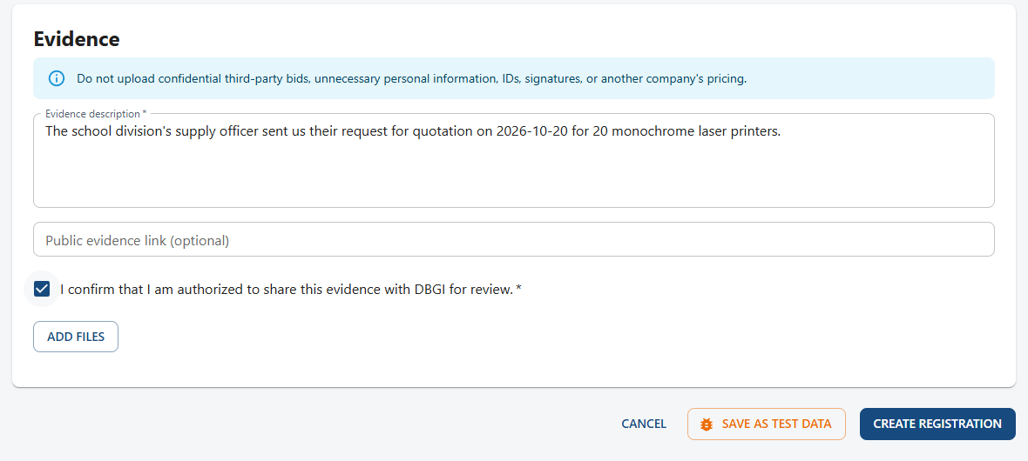
Describe your evidence and submit
Step 2 | Company user
Evidence tells DBGI how you know this opportunity is real
Explain how you learned about the deal, with dates and reference numbers if you have them.
Add files if available. Never upload another company's pricing, IDs, or signatures.
Tick the authorization box.
Select CREATE REGISTRATION.
Requested prices are only proposals until DBGI approves them. Do not promise a requested price to the buyer.

Slide 9
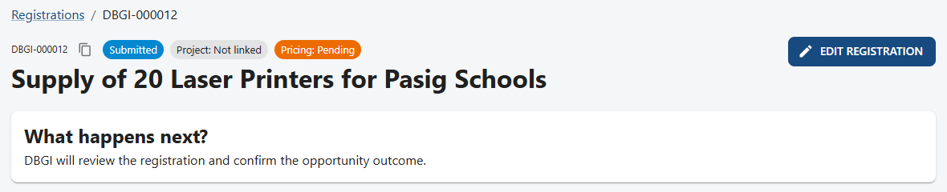
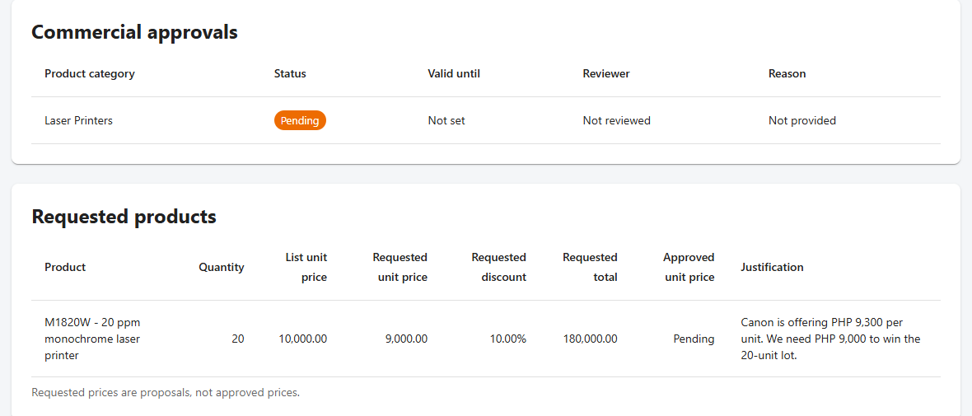
Right after you submit
Step 2 | Company user
The registration gets a DBGI reference and waits for review
Note the reference, here DBGI-000012. Use it whenever you talk to DBGI.
Badges show Submitted, Project: Not linked, and Pricing: Pending.
"What happens next?" always tells you what to do now.
The portal works out the discount you asked for (10%) and the total. Approved unit price stays Pending until DBGI decides.

Slide 10
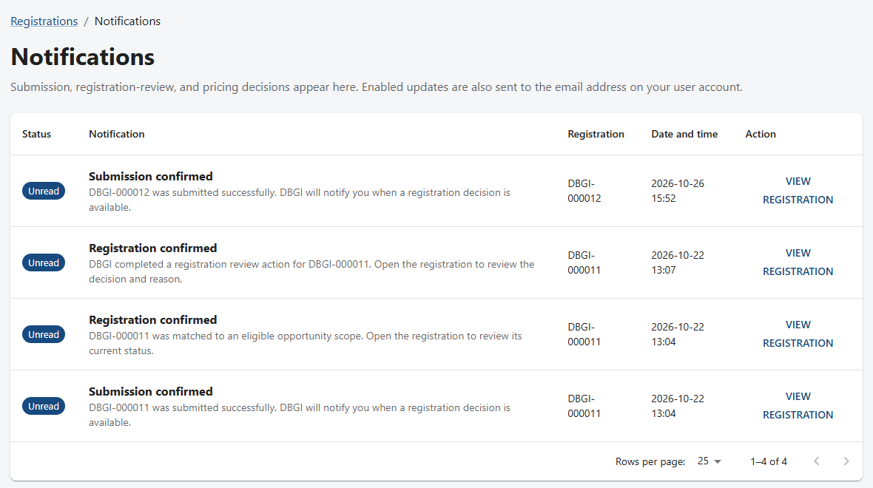
Notifications keep you up to date
Company user
Every submission and DBGI decision appears here
Open NOTIFICATIONS from the top menu.
Unread items are marked. Select VIEW REGISTRATION to open the deal.
Email may send a copy, but the portal notification is the official record.
Check Notifications daily, especially while a registration is waiting for you.

Slide 11
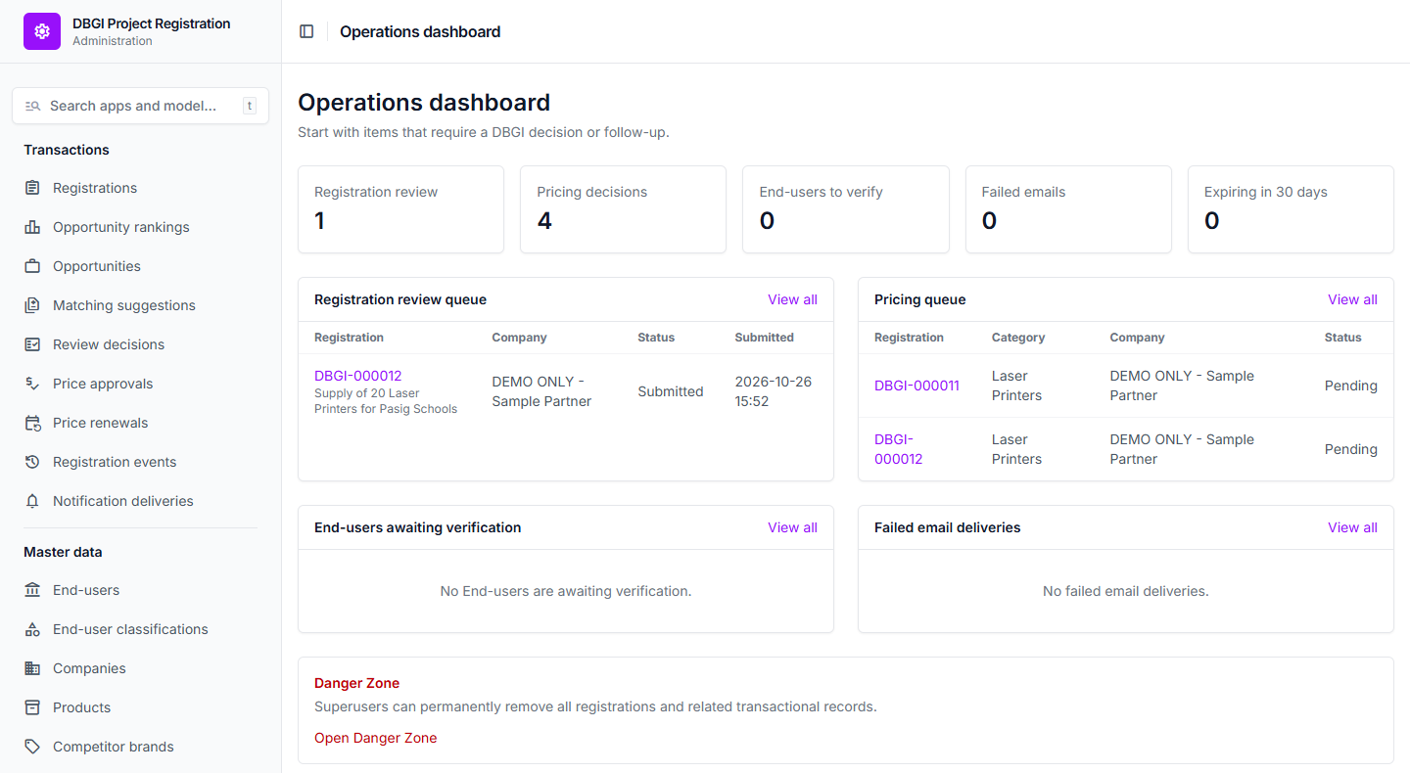
Start each day on the Operations dashboard
Step 3 | DBGI administrator
Administration opens here; it lists what needs a DBGI decision
The cards count work waiting: registration reviews, pricing decisions, End-users to verify, failed emails, and expiring approvals.
The queues below list the actual items. Click a reference to open it.
The left menu has every list, such as Registrations, Price approvals, and End-users.
The Danger Zone at the bottom permanently deletes data. Only superusers can open it.

Slide 12
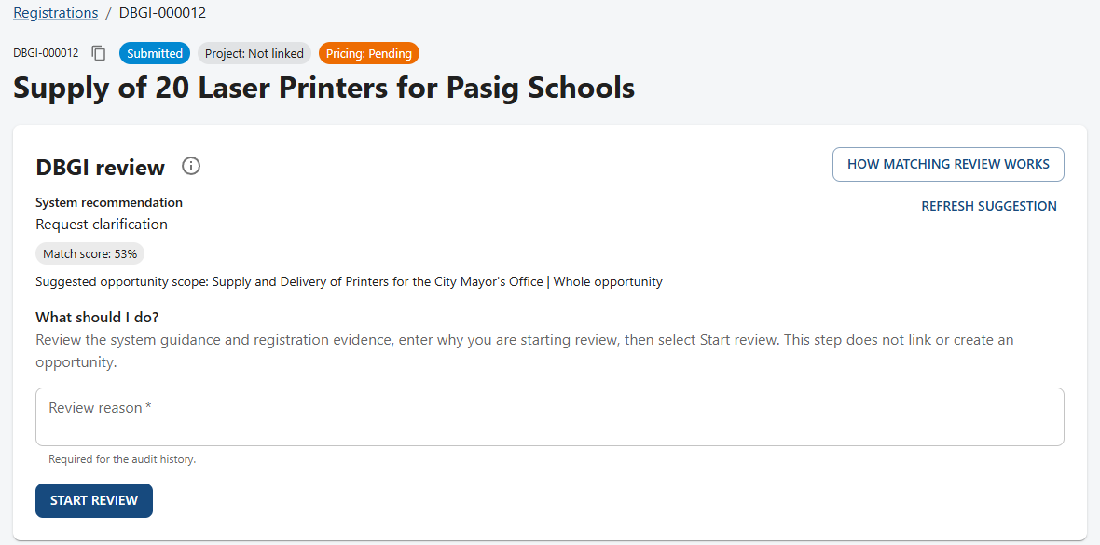
Open the registration and start the review
Step 3 | DBGI administrator
Administrators see a DBGI review panel at the top
Read the system recommendation and match score. They are only suggestions.
Compare the End-user, address, products, and evidence yourself.
Write a short review reason and select START REVIEW. This only marks the review as started.
Never confirm a match from the score alone. Here the score is 53% against a different Pasig project.

Slide 13
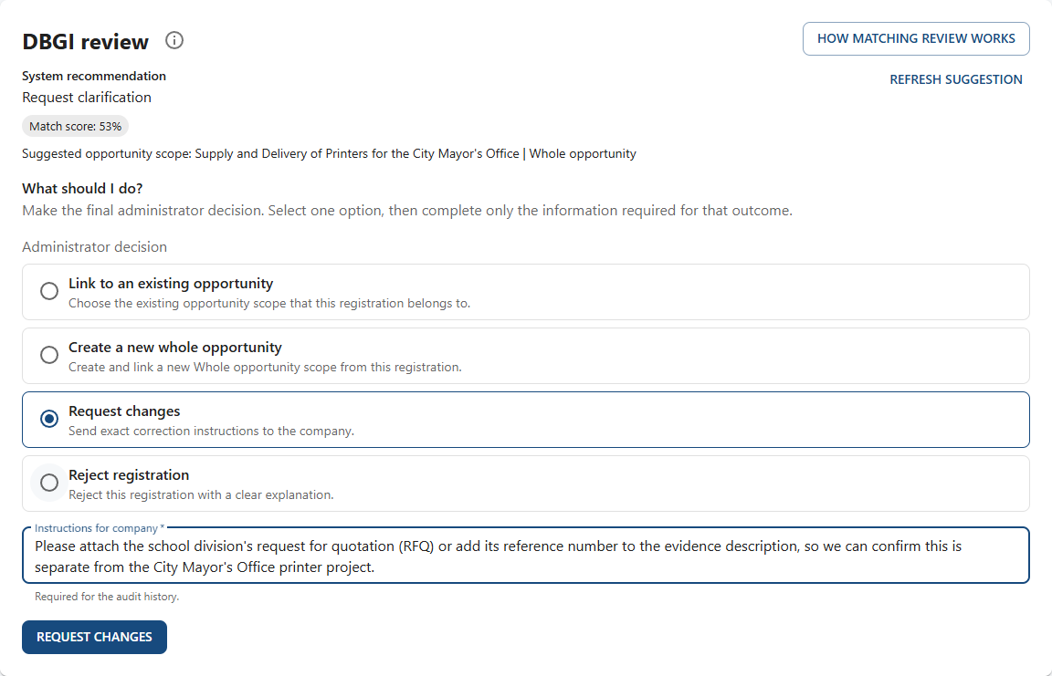
Choose exactly one decision
Step 3 | DBGI administrator
In the example, DBGI asks the dealer for the RFQ reference
Link to an existing opportunity
This deal is the same procurement as one already in the portal.
Create a new whole opportunity
No existing opportunity fits.
Request changes
Something is missing or wrong. Write exact instructions.
Reject registration
Give a clear business reason.
The company is notified automatically after every decision.

Slide 14
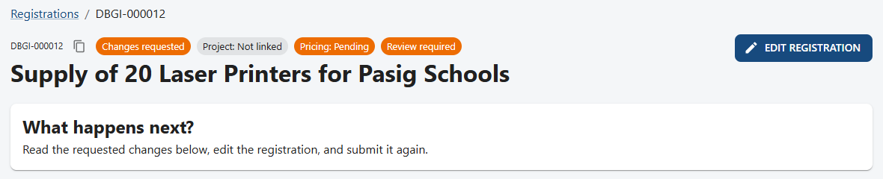
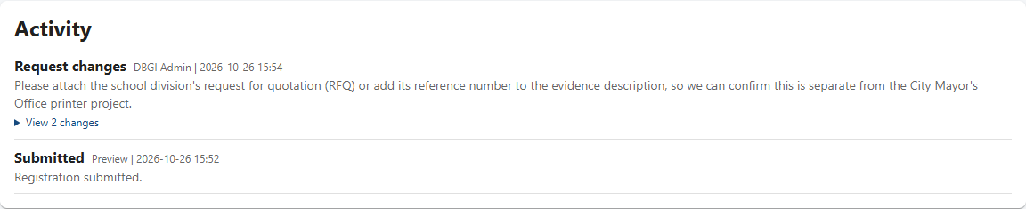
Read what DBGI needs
Step 4 | Company user
The registration now shows Changes requested
Open the Changes requested notification, or the registration itself.
Scroll to Activity. DBGI's exact instructions are under Request changes.
Select EDIT REGISTRATION.
View changes under each Activity entry shows the before and after values for that step.

Slide 15
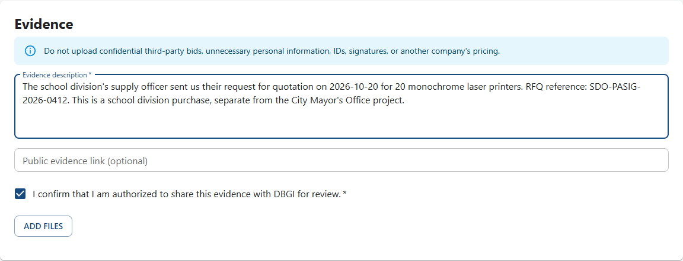
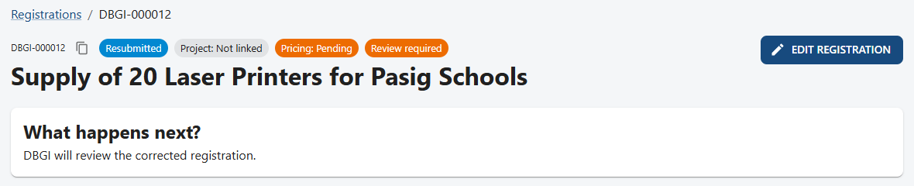
Fix only what was asked, then save
Step 4 | Company user
The same registration goes back to DBGI
Change only the fields DBGI mentioned. Here, the RFQ reference was added to the evidence.
Review everything, then select SAVE CHANGES.
The status becomes Resubmitted. DBGI reviews the corrected version.
Editing a registration that was already Registered also sends it back for review.

Slide 16
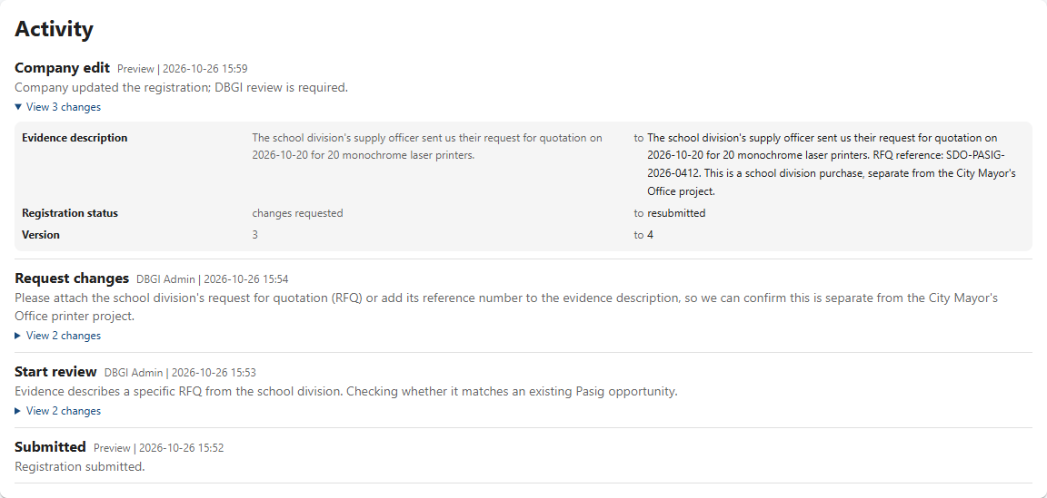
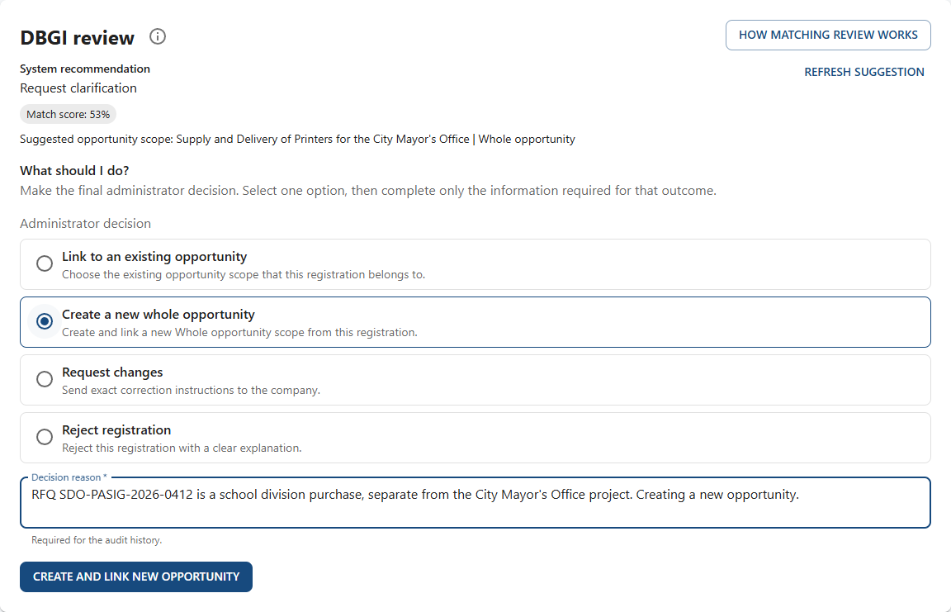
Check the changes, then confirm
Step 5 | DBGI administrator
Activity shows exactly what the company changed
Open the Company edit entry and compare old and new values.
Start review again with a reason.
Pick the final decision. Here: Create a new whole opportunity, because this is a school division purchase.
Result: Registered, Project: Upcoming. The opportunity now exists and ranking can be calculated.

Slide 17
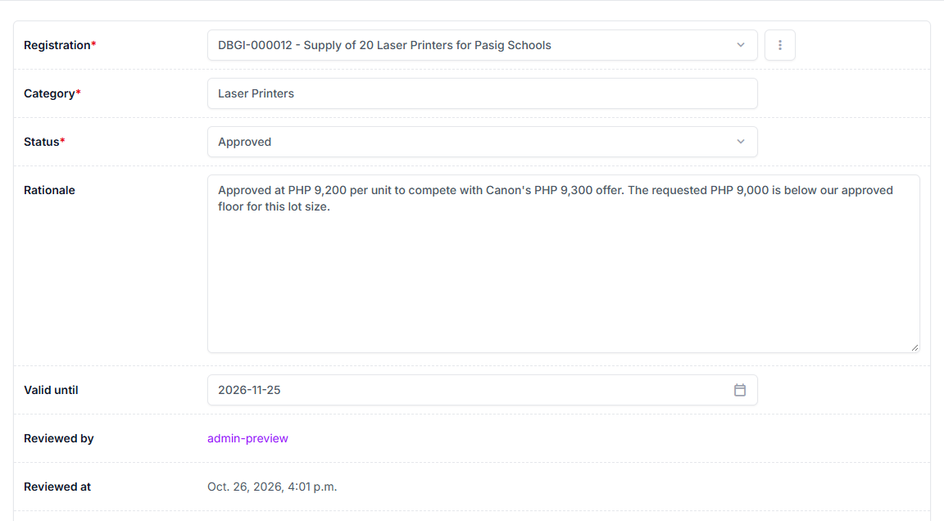
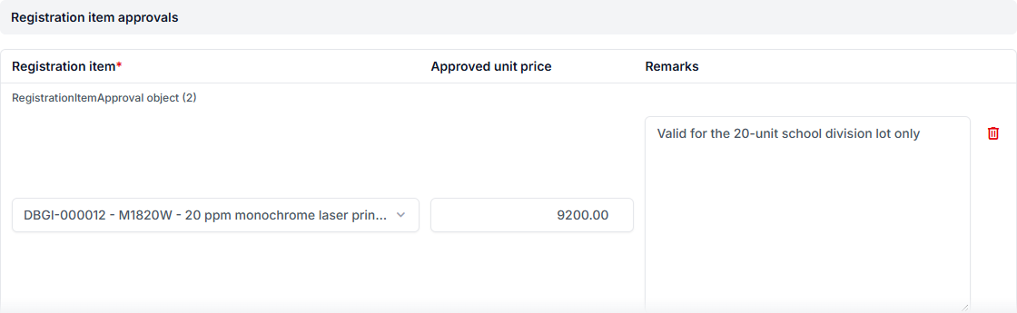
Approve the price
Step 6 | DBGI administrator
Administration, Price approvals (or the dashboard's Pricing queue)
Open the pending category for the registration.
Set Status: Approved, Partially approved, Rejected, or Changes requested.
Write the rationale and set Valid until.
Under Registration item approvals, add the item and its approved unit price.
Select Save. Reviewed by and Reviewed at are filled in with your name and the time.
Only this registration's items are offered, each labelled with its reference, such as DBGI-000012.

Slide 18
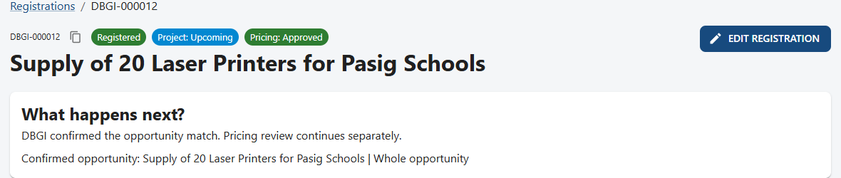
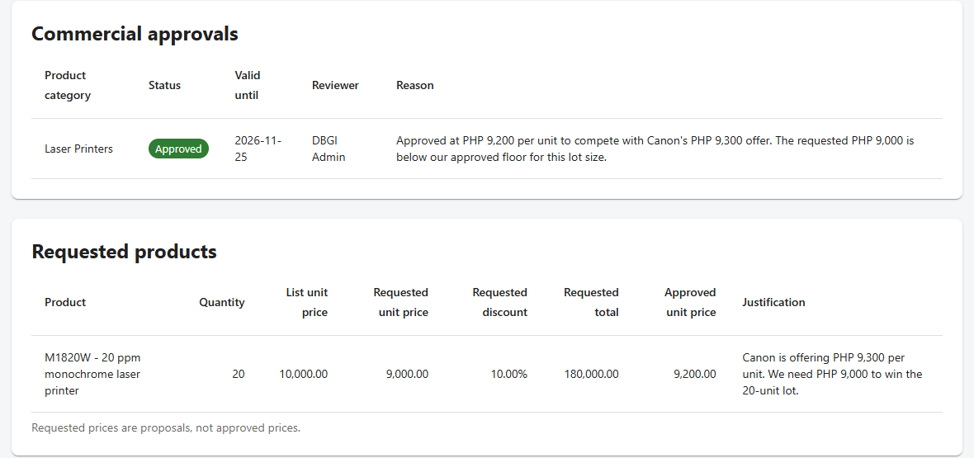
See the decision and the approved price
Step 7 | Company user
All three badges now have an answer
Badges: Registered, Project: Upcoming, Pricing: Approved.
Commercial approvals shows the decision, valid-until date, reviewer, and reason.
Requested products shows the approved unit price: PHP 9,200, not the PHP 9,000 requested.
Quote only the approved price, and only until the valid-until date.

Slide 19
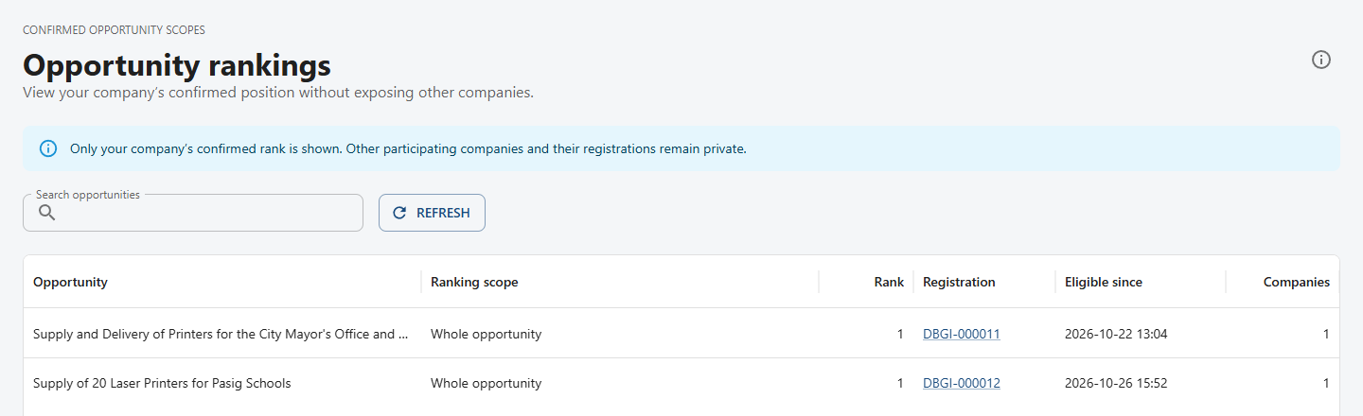
Check your ranking
Step 8 | Company user
RANKINGS in the top menu
Each row is a confirmed opportunity your company registered for, with your rank and the date you became eligible.
You only see your own rank. Other companies and their registrations stay private.

Slide 20
Other situations you will meet
Covered step by step in the portal's Help page
Buyer missing from the End-user list
Company: use Add missing End-user. Admin: Administration, End-users; check the official name and address, add aliases, then verify.
Registration rejected
Read the reason in Activity. Do not resubmit the same deal as a new registration.
An email failed to send
Admin: Administration, Notification deliveries. Fix the address or settings, then retry. The portal notification was never lost.
An approval is about to expire
Admin: the dashboard's Expiring in 30 days card and Price renewals. Each renewal adds 30 days.

Slide 21
Golden rules
If you remember nothing else, remember these
A requested price is never an approved price.
Write reasons and instructions someone else can act on without asking you.
One registration per real opportunity. Edit it; do not duplicate it.
Read the three badges separately: registration, project, pricing.
The portal notification is the official record. Email is only a copy.
Stuck? Open HELP. It has step-by-step guides for your role.

Slide 22
Quick reference: where do I go?
I want to... | Go to
Register a new deal | Registrations, then NEW REGISTRATION
See what DBGI decided | NOTIFICATIONS, then VIEW REGISTRATION
Fix a registration DBGI sent back | Open the registration, read Activity, EDIT REGISTRATION
See my approved price | Open the registration: Commercial approvals and Requested products
See my rank | RANKINGS
Review a registration (DBGI) | Administration dashboard, Registration review queue
Decide a price (DBGI) | Administration, Price approvals
Get step-by-step help | HELP in the top menu

